Slide 1
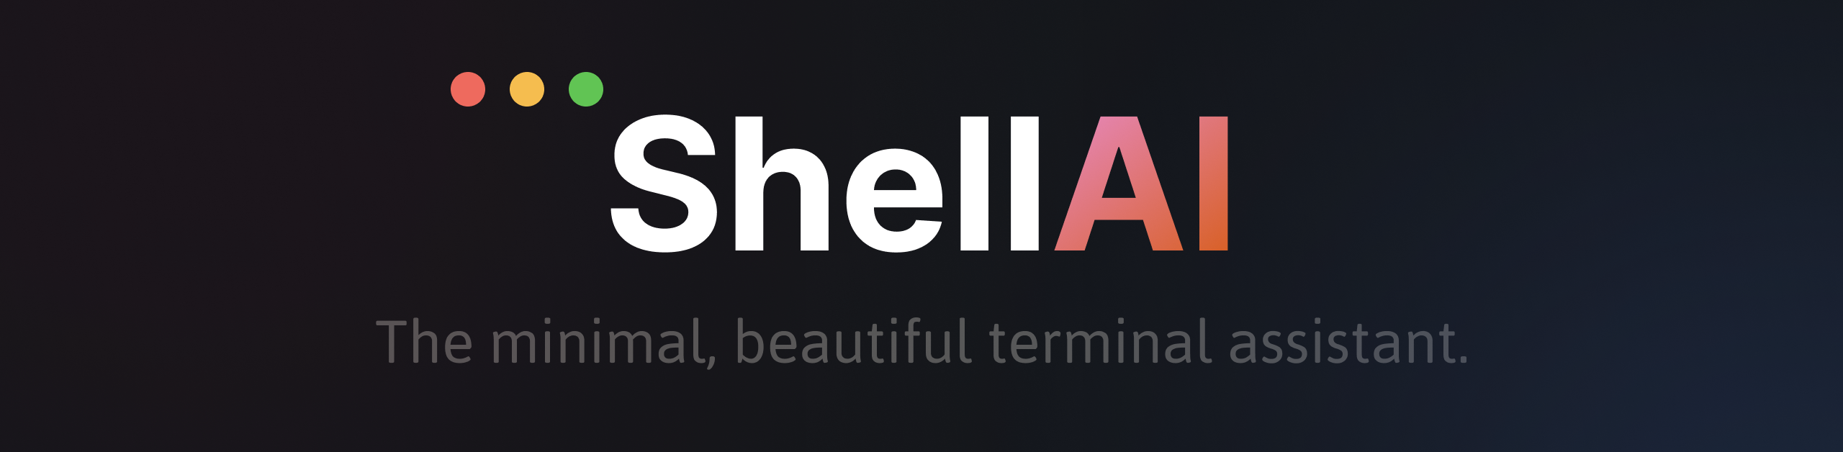

Slide 2
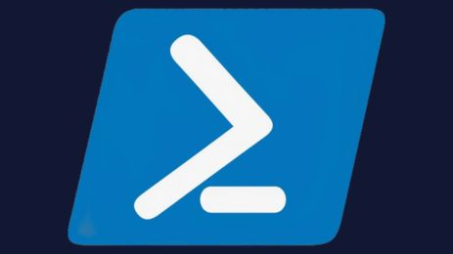
PShell AI
The minimal, and beautiful terminal assistant.

